Slide 1




www.makeithappen.club
Cluster Event

Slide 2
Today
Sample Pitch
Workshop 1 - Your Pitch!
Top Tips
Workshop 2 - Screen Story Board!
Surprise!

Slide 3
www.makeithappen.club

Slide 4

Think It
Design It
Build It

Slide 5
Sample Submission

Slide 6
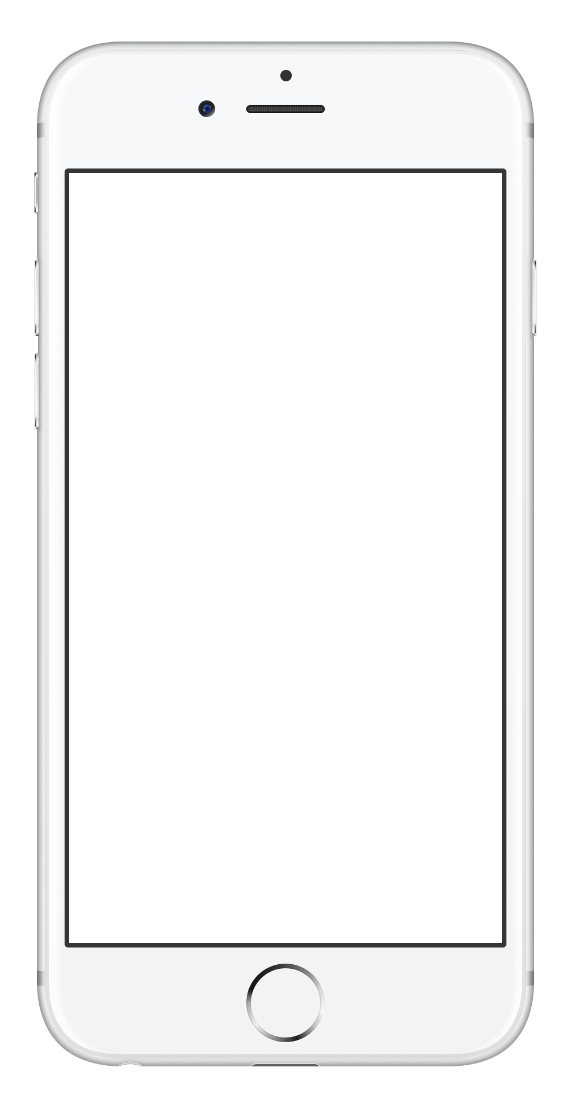
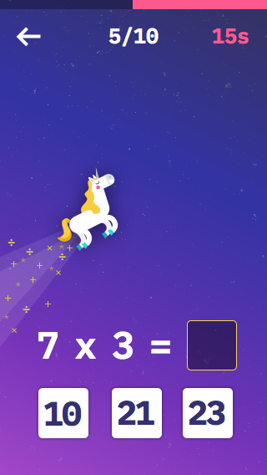

Make It Happen Winner

Slide 7
Workshop 1
Your Pitch!
Work in your teams to design your own pitch

Slide 8
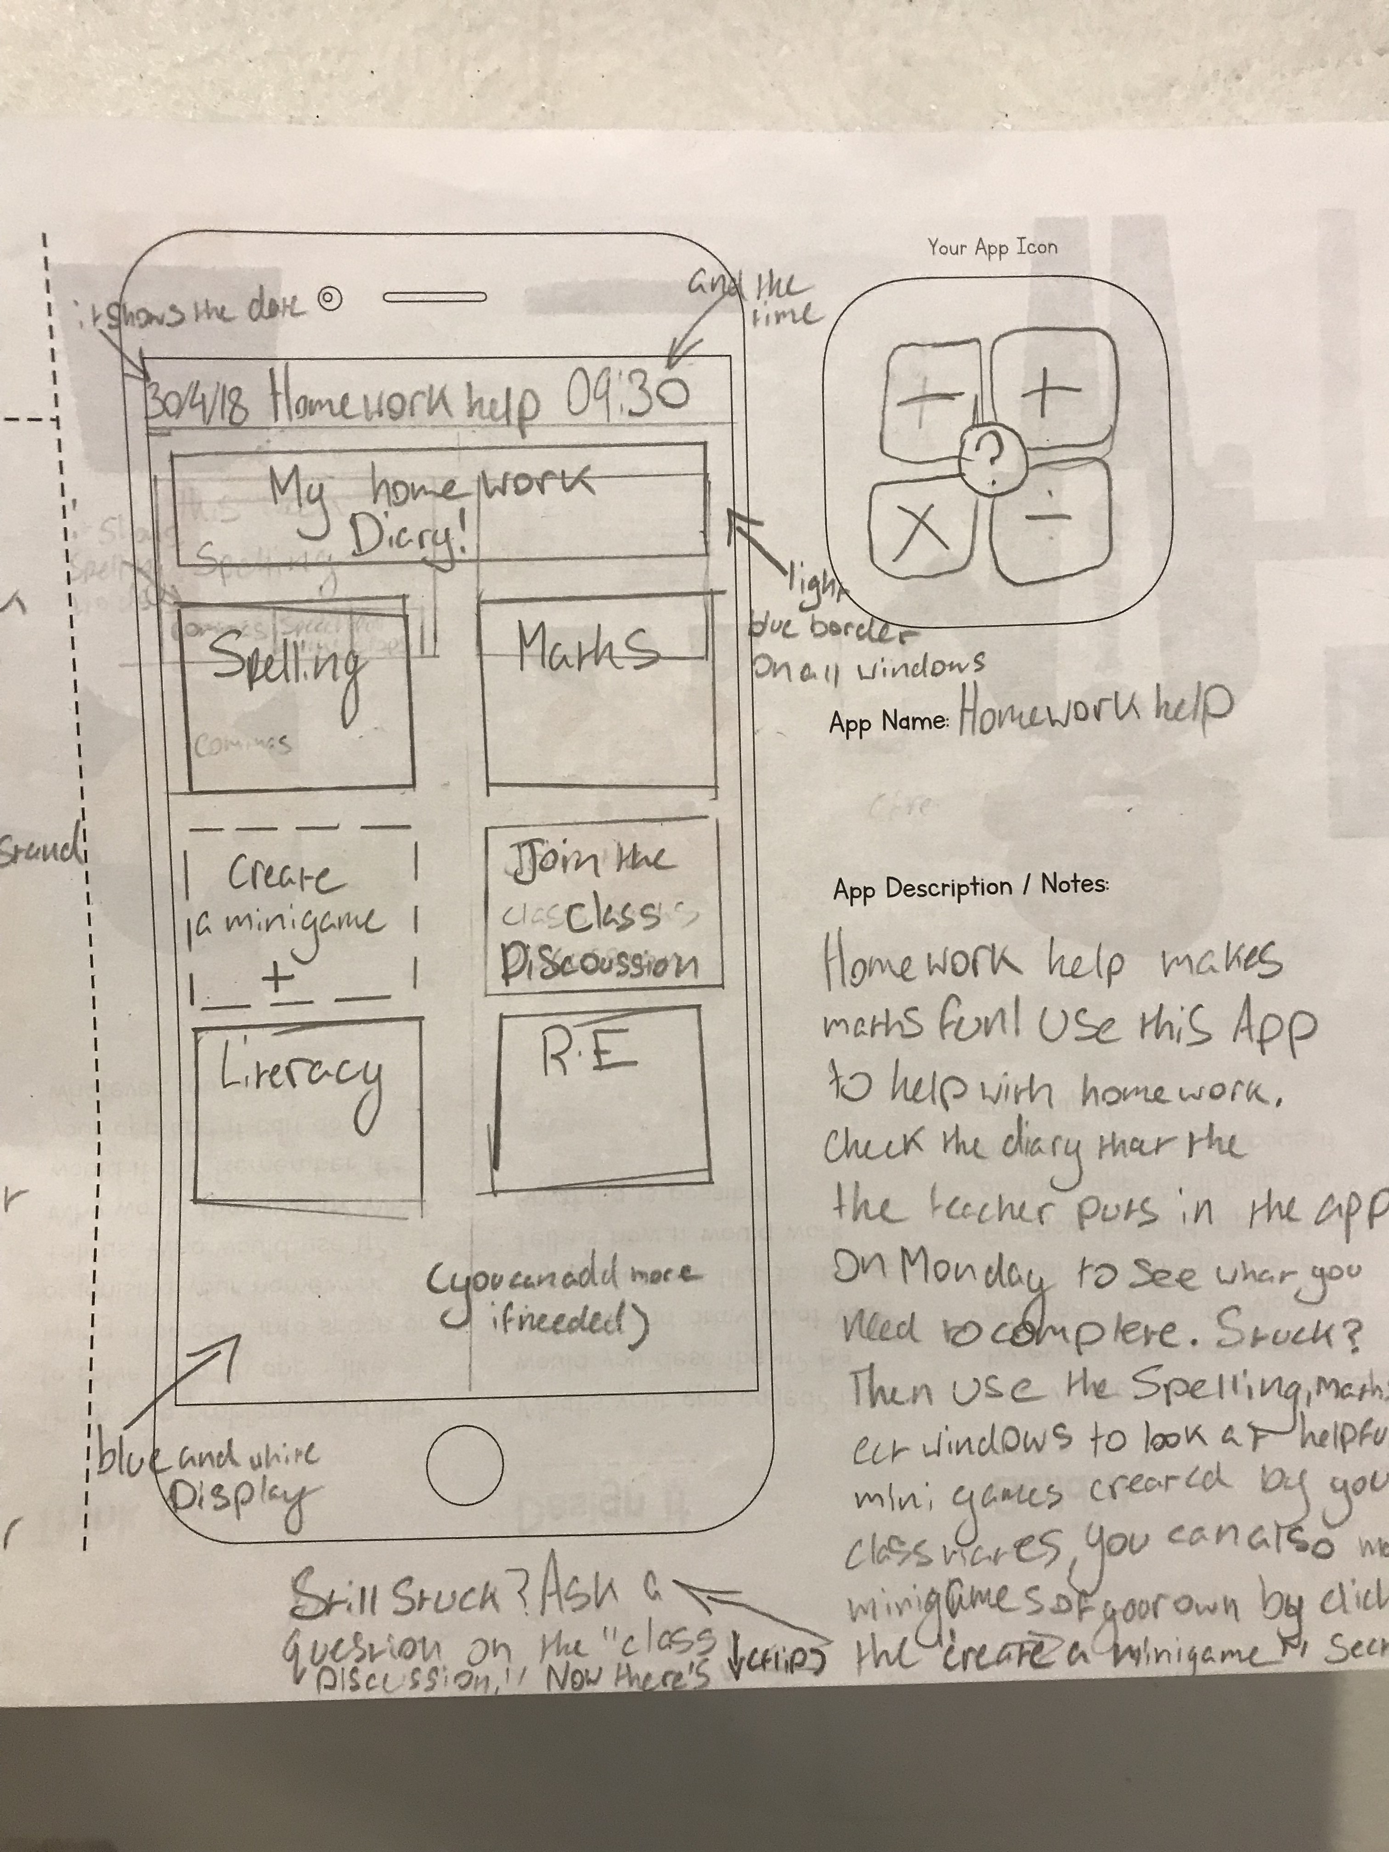
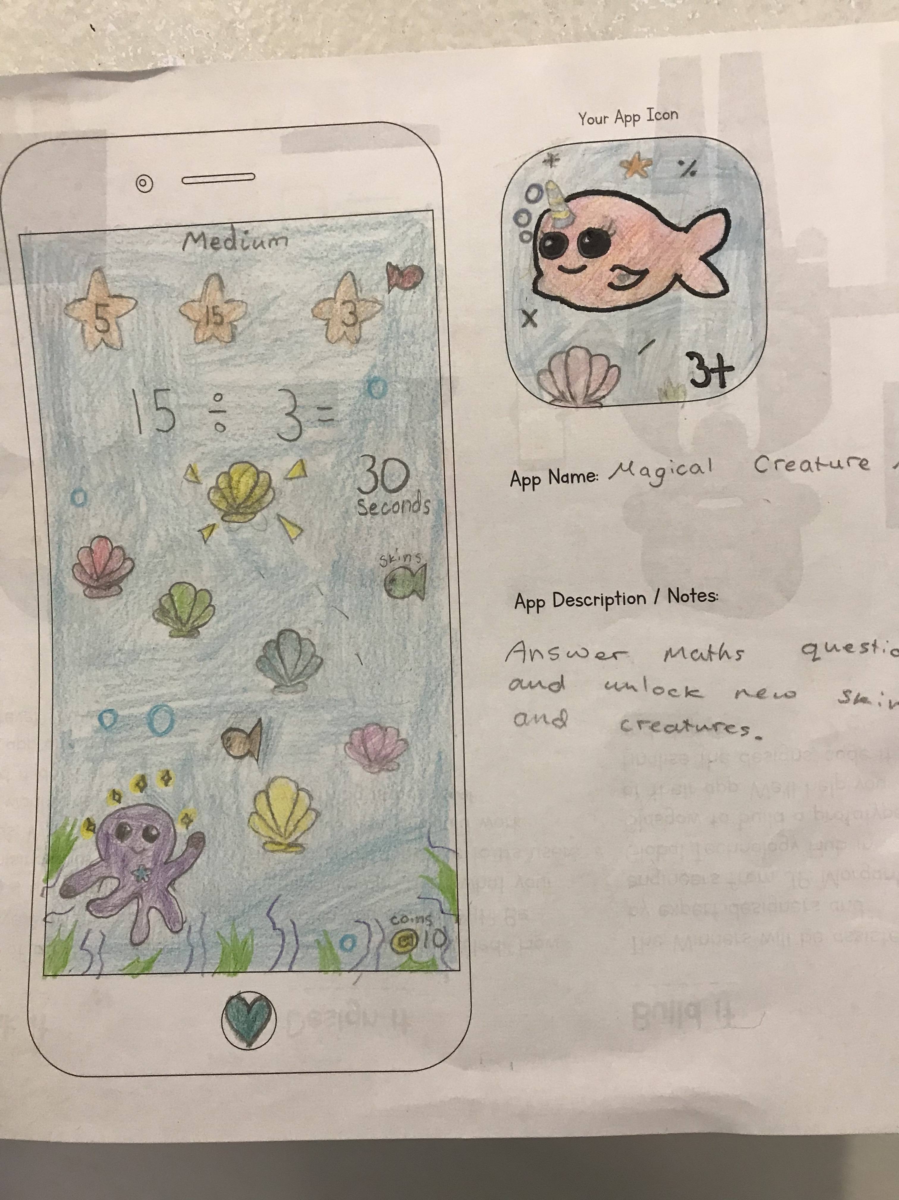
Top Tip #1
Keep It Simple!

Slide 9




Top Tip #2
Story Board … like a Book!

Slide 10

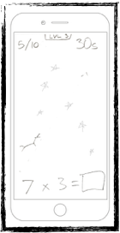



9
Start
Finish
Welcome
Quiz
Results
Start
Create Question
Check Answer
Update Score
Countdown Timer
Move Unicorn
Show Score
Finish

Slide 11
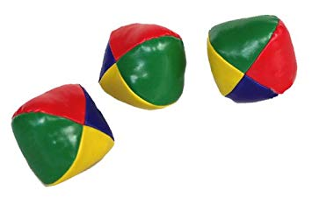
Top Tip #3
Don’t Juggle too Much!

Slide 12
Workshop 2
Story Board Screens
Create a Screen Story Board for your App

Slide 13
Surprise…

Slide 14
Make It Happen
Ambassadors!

